Slide 1

19Sw74 Syed Sahir shah
My journey As software Engineer

Slide 2


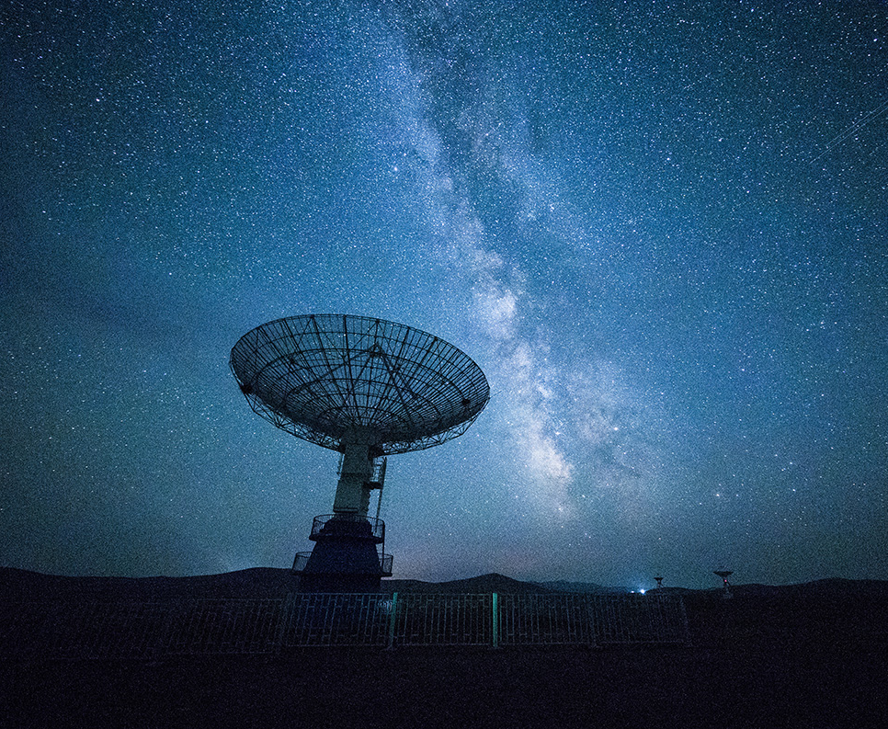
Introduction
I am software Engineer From Mehran University of Engineering and technology here is my journey in this feild

Slide 3
Early Life
As a child, I was always fascinated with technology and how it worked. I was constantly tinkering with gadgets and figuring out how things worked. It was during this time that I was introduced to programming, which sparked my interest in software engineering.

Slide 4
Education
I pursued a degree in Software Engineering and took courses that taught me the fundamentals of programming. During my time in school, I also took on various internships to gain practical experience.

Slide 5
Career Journey
During my education, I landed my first job as a software engineer at a startup. It was an exciting and challenging experience, but it taught me a lot about teamwork, communication, and problem-solving. Over the years, I worked for various companies, gaining new skills and knowledge along the way.

Slide 6
Skillset
As a software engineer, I have expertise in programming languages such as Java, Python, and JavaScript. I'm also familiar with various frameworks and tools such as Spring Boot, React, and Git

Slide 7
Achievements
Throughout my career, I've worked on numerous projects that I'm proud of. One notable achievement was building a mobile app that received over a thousands downloads. I've also received awards for my contributions to the development community

Slide 8
Challenges
As a software engineer, I've faced my fair share of challenges, including debugging complex code and managing large-scale projects. However, I've learned that perseverance, attention to detail, and effective communication can help overcome these obstacles.

Slide 9
Lessons Learned
Throughout my journey as a software engineer, I've learned that collaboration, continuous learning, and adaptability are essential skills for success. I've also learned that the ability to think critically and approach problems with a creative mindset can lead to innovative solutions.

Slide 10
Conclusion
In conclusion, my journey as a software engineer has been challenging but rewarding. I'm grateful for the experiences I've had, the knowledge I've gained, and the people I've met along the way. If anyone has questions or wants to connect, feel free to reach out to me.

Slide 11

Thank You!
Syed Sahir shah

